Slide 1
Sales dashboard
Dr. Rakhee

Slide 2
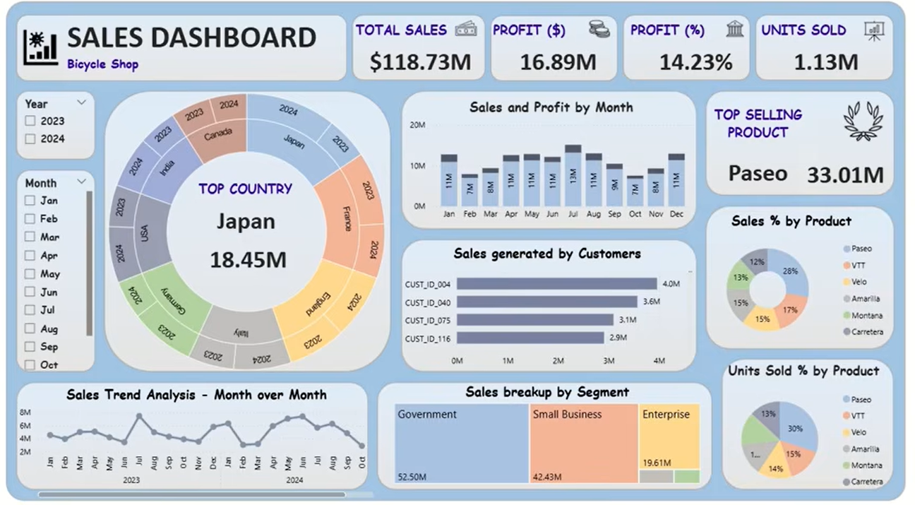

Slide 3
Components
KPI Cards
Donut Chart
Column Chart
Bar Chart
Pie Charts
Treemap
Line Chart
Slicers

Slide 4
Business Questions
Total Sales?
Total Profit?
Profit Percentage?
Units Sold?
Best Selling Product?
Top Country?
Monthly Sales Trend?
Customer Performance?
Segment Contribution?
Product Contribution?

Slide 5
Data Cleaning
Power Query Steps
Remove Null Values
Change Data Types
Remove Duplicates
Rename Columns
Create Date Table
Split Columns
Merge Tables

Slide 6
Create Date Table
Calendar = CALENDAR(MIN(Sales[Date]),
MAX(Sales[Date]) )
OR
Calendar = CALENDARAUTO()

Slide 7
Create Calculated Columns
Column | DAX
Year | Year=YEAR(Calendar[Date])
Quarter | Quarter = "Q" & QUARTER(Calendar[Date])
Month Number | Month Number = MONTH(Calendar[Date])
Month | Month = FORMAT(Calendar[Date], "MMMM")
Month Short | Month Short = FORMAT(Calendar[Date], "MMM")
Year Month | Year Month = FORMAT(Calendar[Date], "MMM yyyy")
Week Number | Week Number = WEEKNUM(Calendar[Date],2)
Day | Day = DAY(Calendar[Date])
Month Sort | Month Sort = YEAR(Calendar[Date])*100 + MONTH(Calendar[Date])

Slide 8
DAX Measures
Total Sales = SUM(Sales[Sales])
Total Profit = SUM(Sales[Profit])
Units Sold = SUM(Sales[Quantity])
Profit % = DIVIDE([Total Profit],[Total Sales])
Top Product Sales = MAXX(VALUES(Product[Product]),[Total Sales])
Rank Product = RANKX(ALL(Product[Product]),[Total Sales])
Top Country = TOPN(1,VALUES(Country[Country]),[Total Sales])

Slide 9
KPI Cards
Setting | Value
Visual | Card
Field | Total Sales
Measure | SUM(Sales[Sales])
Callout → value →Display Units | Millions
Decimal Places | 2
Title | TOTAL SALES
Background | White
Border | On
Font | Segoe UI / Poppins
Callout Font Size | 32–40

Slide 10
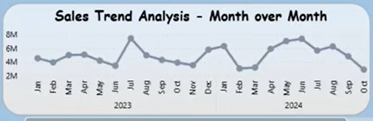
Visual Setting | Field
Visual | Line Chart
X-Axis | Calendar[Year Month]
Y-Axis | Total Sales
Legend | None
Tooltip | Total Sales
Filters | Year, Month (optional)

Slide 11
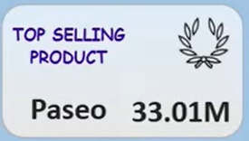
Step 1: Create Total Sales Measure | Total Sales = SUM(Sales[Sales])
Step 2: Create Product Rank Measure | Product Rank = RANKX( ALL(Product[Product]), [Total Sales], , DESC, DENSE )
Step 3: Create Top Product Name Measure | Top Product = CALCULATE( SELECTEDVALUE(Product[Product]), TOPN( 1, ALL(Product[Product]), [Total Sales], DESC ) )
Step 4: Create Top Product Sales Measure | Top Product Sales = MAXX(TOPN(1, VALUES(Product[Product]), [Total Sales], DESC ), [Total Sales] )
Insert a Multi-row Card – add Top Product and Top Product Sales
Format the card as per requirement

Slide 12
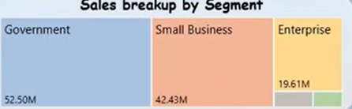
Treemap
Treemap Field | Column
Group | Segment
Values | Total Sales
Format the Visual
Title
Format → General → Title
Title: Sales Breakup by Segment
Font Size: 18
Font Family: Segoe UI / Poppins
Bold: On
Alignment: Center
Data Labels
Format → Data Labels
On
Display Units: Millions
Decimal Places: 2
Font Size: 12

Slide 13
Property | Value
Visual | Treemap
Group | Segment
Values | Total Sales
Tooltips | Profit, Profit %, Units Sold
Sort | Total Sales (Descending)

